Slide 1

Fundamentals of Energy Efficient Building Operations
Part 3: Lighting Fundamentals
Notes:
Instructor’s name: __________________________________________________________
Phone number: ____________________________________________________________
E-mail: ___________________________________________________________________
_________________________________________________________________________
_________________________________________________________________________
_________________________________________________________________________

Slide 2
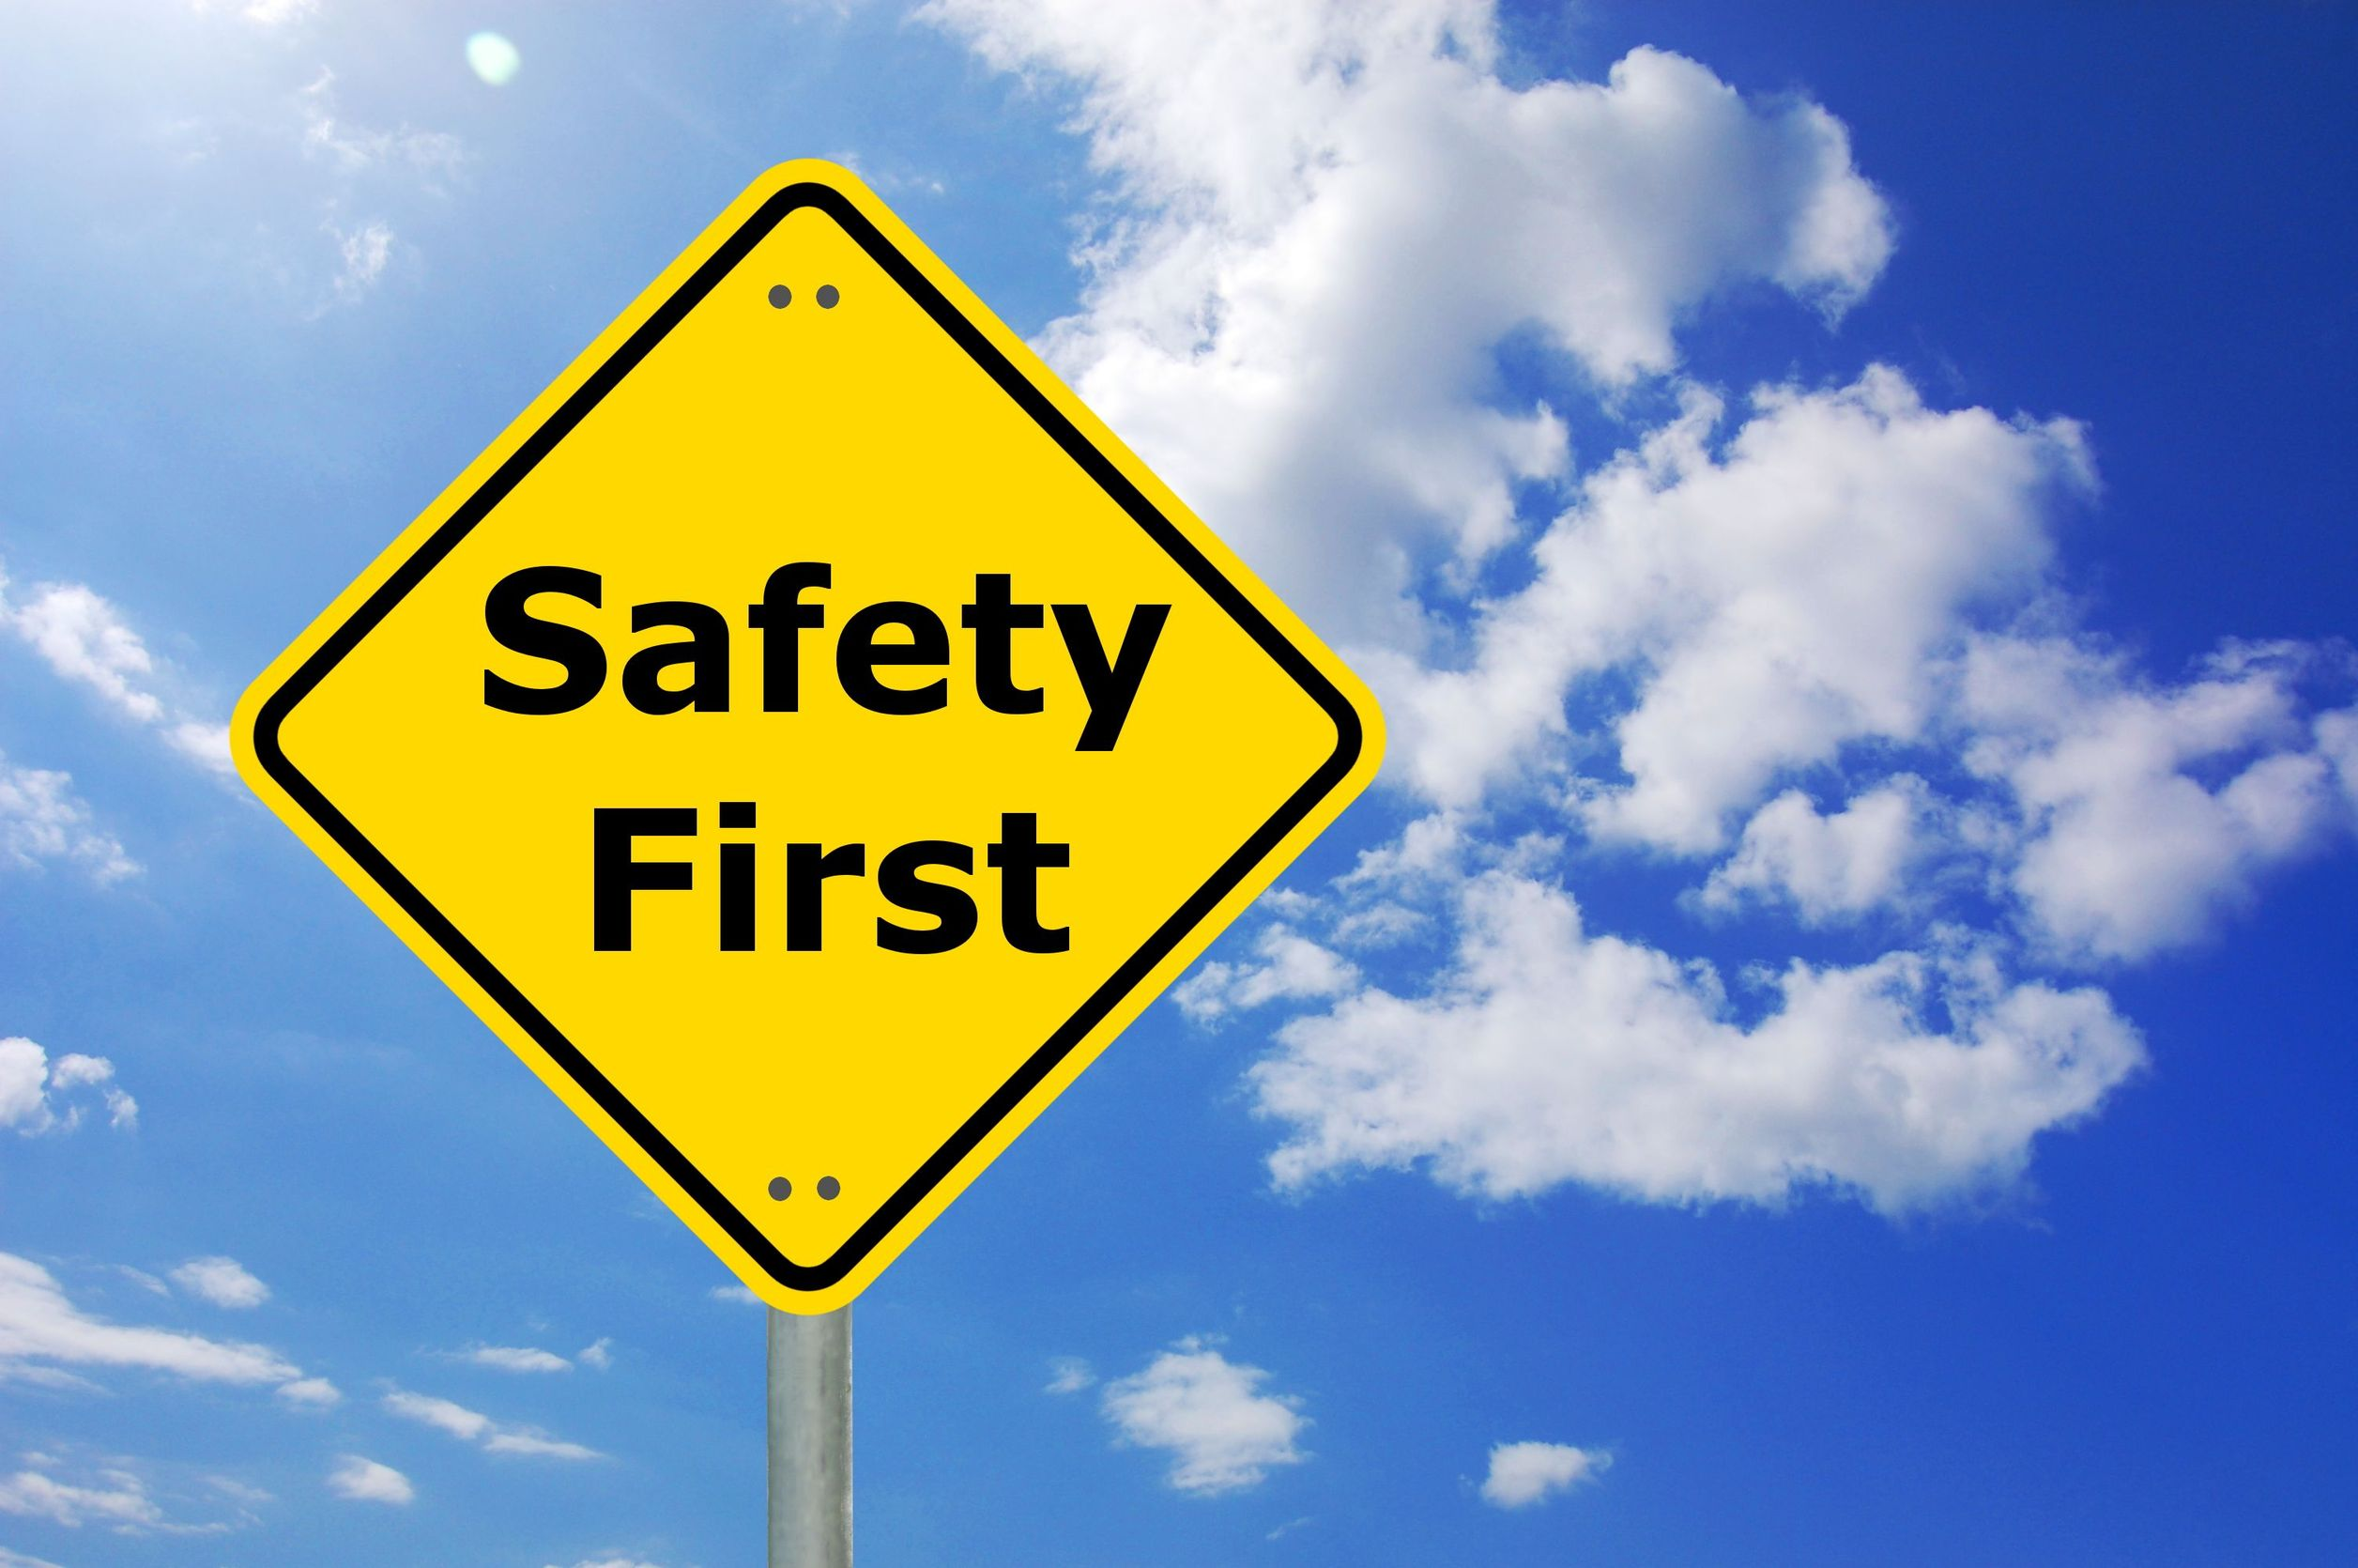
Safety Message
Notes:
Let's start with a safety reminder. This may be something from the course sponsor or site host; the instructor, moderator, or a student. Topics can include anything related to safety: site, health, personal, equipment, etc. What topic shall we address today?

Slide 3
Part 3 Agenda
Lighting Principles
Lighting Equipment
Learning Activity – Using a Light Meter
Lighting Maintenance
Lighting Efficiency

Slide 4
Importance of Lighting to Building Occupants
Lighting affects occupants’ ability to:
Connect with the outdoor environment
Navigate through the building
Exit in case of emergency
Perform tasks
Notes:
We’ve discussed how thermal comfort and air quality are important aspects of the indoor environment in optimizing human health and performance. Other important aspects are acoustics and lighting. This class will focus on lighting, which is important for occupants to be able to perform tasks, to feel a connection with the outdoor environment, to find their way through the building, and for life safety in case of an emergency. Lighting can also affect how occupants perceive and experience a space and the activities occurring in it.

Slide 5
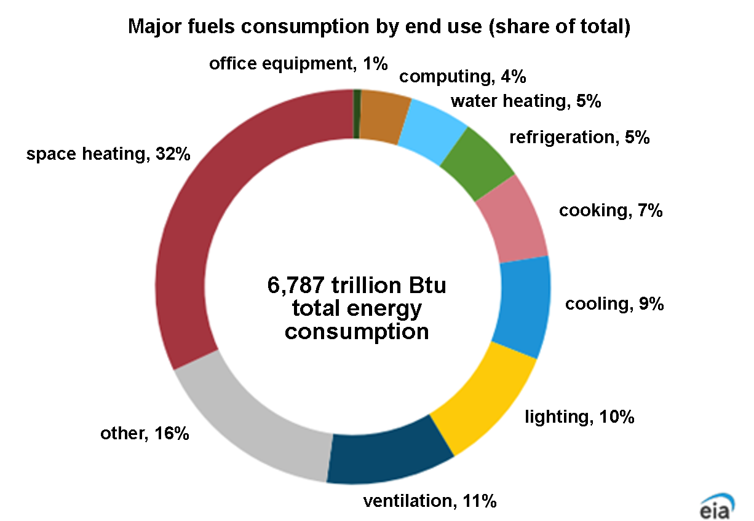
Why Energy Efficient Lighting?
Notes:
As this chart shows, space heating is the most common end use in commercial buildings, comprising 32% of energy consumption. Lighting is also a sizeable end use, consuming 10% of total consumption. Lighting often presents a relatively easy savings opportunity, with the advent of higher efficiency options. LEDs are shaping current market dynamics, and competition among manufacturers is driving further innovation, wider product choices and lower prices.
The Other category of electricity use includes miscellaneous electric loads (MELs), process equipment, motors, and air compressors.
Globally, electricity consumption for lighting increased in 2022, with greater efficiency not offsetting increased use of lighting. Despite the falling carbon intensity of electricity, CO₂ emissions from lighting rose slightly in 2022. 2022 saw continued progress both in the deployment of light-emitting diodes (LEDs) and in lighting efficiency. While numerous countries began to phase out incandescent lamps more than ten years ago, many are now beginning to eliminate fluorescent lighting as well, making LEDs the dominant lighting technology. About 50% of global residential lighting sales use LED technology.
Image source: U.S. Energy Information Administration. Data from Commercial Buildings Energy Consumption Survey (CBECS), 2018.

Slide 6
Efficient Lighting Practices
Maintain recommended light levels and correct when too high or too low:
Provide the amount of light needed for the task.
Select efficient lighting products:
Meet lighting efficiency and maintenance goals.
Control the operation of lighting systems:
If not needed turn them off.
If not needed at full output turn them down (dimming).
Notes:
The principles of efficient lighting are not complicated. They just require a good understanding of a facility’s lighting needs and choosing equipment in the marketplace that can best meet those needs.
One role for building operators is to make sure that proper light levels provide the amount of light needed.
Another role of the building operator is to maintain lighting systems for maximum performance and to provide ongoing maintenance to ensure efficient operation and long life.
Maintenance of lighting controls will help make sure that lighting is not left on for extended periods of time and is turned off when not needed.
The practice of effective lighting management depends on using proven efficient lighting equipment and providing well documented maintenance.

Slide 7
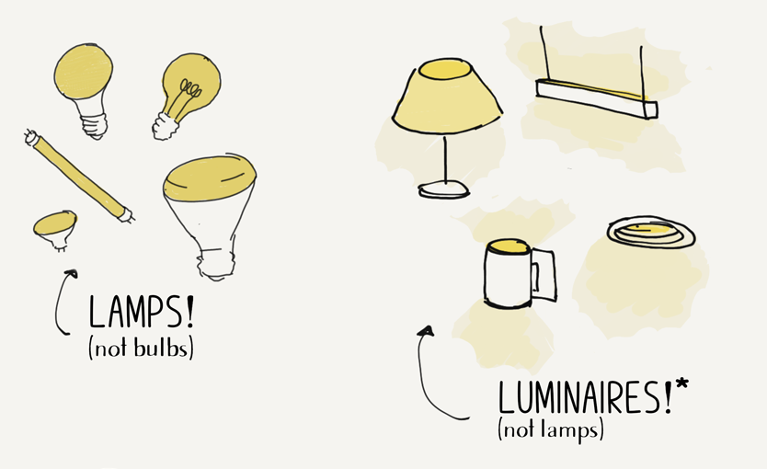
Terms: Lamp & Lumen
Lamp
Lumen
Luminaire
Measurement unit used to quantify the total amount of light produced by a lamp or fixture
Includes all types of bulbs and tubes
A complete lighting unit consisting of a light source and other components required for its operation and distribution of the light.
Image source: https://www.renfrodesign.com/page/lamp-vs-luminaire
Notes:
A lamp is a general term that refers to the enclosure of the light source, the light producing elements and their connection to power. A lamp includes all types of bulbs and tubes, and is rated in lumens (also known as total lumens, lamp lumens, or light source lumens).
A lumen is the term given to a unit of light visible to the human eye. Lamp catalogs list the lumen ratings for lamps. A lamp with a higher lumen rating produces more light. Values found in lamp catalogs can vary by manufacturer for the same lamp. A catalog rating for standard, 32 watt T8 tubes is 2900 lumens, but can also be 2850 or 2950, depending on the manufacturer, for example.
A luminaire refers to a complete lighting unit consisting of a light source, power supply, ballasts or drivers, and other components required for its operation and distribution of the light. This term is sometimes used interchangeably with the term “light fixture”.

Slide 8
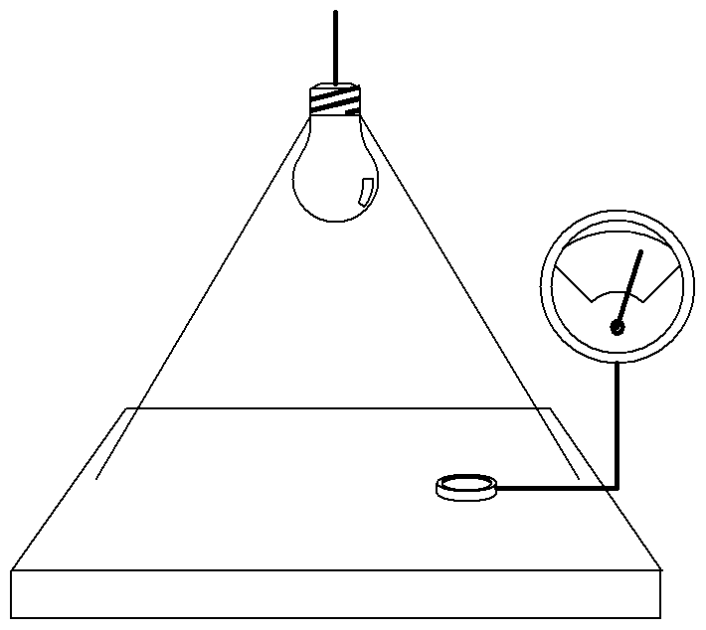
Term: Light Level (FC)
Foot Candle (FC):
Measure of light level
Taken with a light meter
lumens
square feet
FC =
*Lux is the international unit and is approximately 10 x per FC.
(i.e., 20 FC ~= 200 lux)
Notes:
Footcandle (FC) is the amount of light falling on a surface. It is the most practical measurement of illumination. It is defined as the amount of light (lumens) divided by the area in square feet (lumens/SF). Note: This formula provides an estimate, as environmental factors can affect FC readings.
The light level in footcandles is dependent on the distance of the light source to the surface being lighted. Light meters are used to measure lighting levels in footcandles. Inexpensive light meters with reasonable accuracy are widely available. Light meter apps for smartphones are also available but are typically not very accurate, so these should be used for demonstration purposes only.
LUX is the SI (International System) derived unit of illuminance and luminous emittance, measuring luminous flux per unit area. It is equal to one lumen per square.

Slide 9
Term: Lumen Depreciation
Lamps lose light output (lumens) over time
Fixtures lose ability to reflect or transmit light
Losses commonly due to:
Expressed as percentage (%) of initial lamp or fixture condition
Lighting systems can be returned to initial condition by cleaning and re-lamping
lamp aging
lamp burn out
dirt accumulation and/or heat
Notes:
Initial Light Level reflects the condition when a new, or newly-cleaned system is fully operational. Lenses and reflectors that are clean are more efficient. New lamps are performing at their highest level in that application. An important characteristic of a new lamp is that it is producing more lumens than the rated value in a lamp catalog. The most accurate measurement of lamp lumens is the mean lumens indicated in the lamp catalog. Mean lumens indicate the average lumens available in the lamp over lifetime.
Lumen Depreciation: Lumen depreciation refers to the loss of the original light output of the lamp or fixture that occurs over time. Lamps and fixtures do not work like new throughout their lifetimes. Light output normally depreciates over time. As fixtures and room surfaces accumulate dirt, there is a reduction in the amount of transmitted or reflected light. The percentage of depreciation is expressed so that the value shows how much light is still available. A depreciation of 75% means that the light output is 75 percent of the initial light output.

Slide 10
Discussion Question
The total amount of light that a bulb or tube produces is measured in:
Footcandles (FC)
Watts
Lumens
CRI

Slide 11
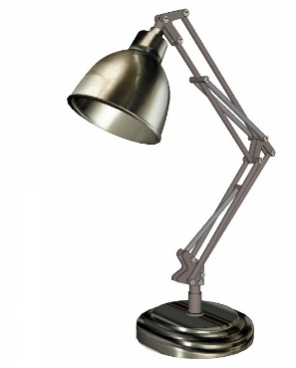
Lamp Characteristics: Lumens per Watt (LPW)
light output (lumens)
power input (watts)
LPW =
Measure of the efficacy of traditional lamps
Higher efficacy lamps have higher LPW ratings
Like miles-per-gallon rating for a car
Always consider the efficacy of a system to include ballasts/drivers/transformers/fixtures, etc.
Notes:
It is useful to compare the efficacy of light sources using lumens per watt (LPW). LPW is a measure of a lamp’s efficacy or how well a lamp converts electricity into light. The higher the LPW the less energy you need for the same amount of light and the lower your electric bill will be per month. It’s one of the best ways to compare the efficiency of lamps. Lamp efficacy is similar to the miles-per-gallon (MPG) rating for a car and both are good aids when comparison shopping.
LPW is calculated by dividing the lumen output by the watts consumed. For example, the LPW of a typical T8 fluorescent tube is 91, or 2900 lumens divided by 32 watts.
A typical LED lamp or fixture ranges in efficacy from around 100 to 150 LPW while an incandescent lamp is as low as 16 LPW. This is an impressive difference. Of course, there are always outliers that fall outside of these average ranges, so it is best to consult manufacturers specifications prior to purchasing equipment.
LED technology continues to improve, and the efficacy of LEDs will likely continue to improve as well.

Slide 12
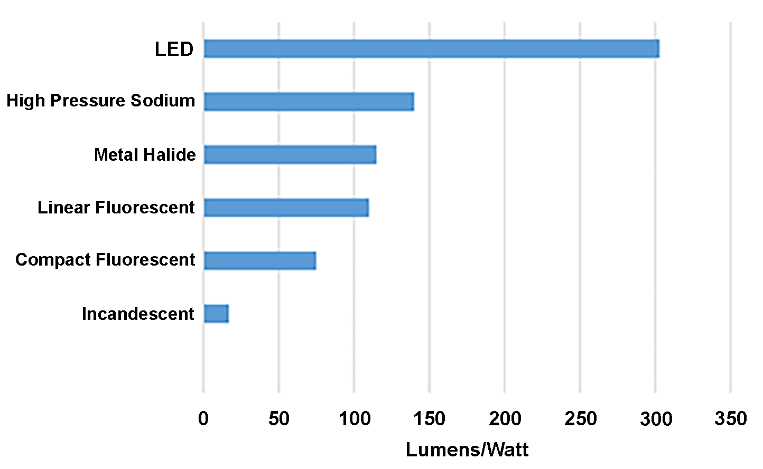
Efficacy for Common Light Sources (lm/W)
Notes:
Because only a fraction of electrical energy is converted to light, most of it is converted directly to heat energy; thus, lights are a significant source of internal heat gain in buildings.
The level of illumination is affected by the output of the lamp, the distance of the lamp from the illuminated surface, and the reflection and absorption of light from the fixture and at various surfaces in the room and from other external light sources, such as outdoor light coming in through windows.
The goal of lighting is to provide illumination of a certain area, so the effectiveness of lighting should always be judged based on illumination levels.
This graph shows the approximate range of efficacy possible for various common light sources, given in lumens per watt (lm/W). Clearly, LED is far superior in delivering desired light levels using less energy.
Note: the efficacy of bare conventional lamps can vary based on construction, materials, wattage, or other factors.
SOURCE: https://jdrm.com/services/electrical/lighting/is-led-lighting-right-for-you/luminous-efficacy

Slide 13
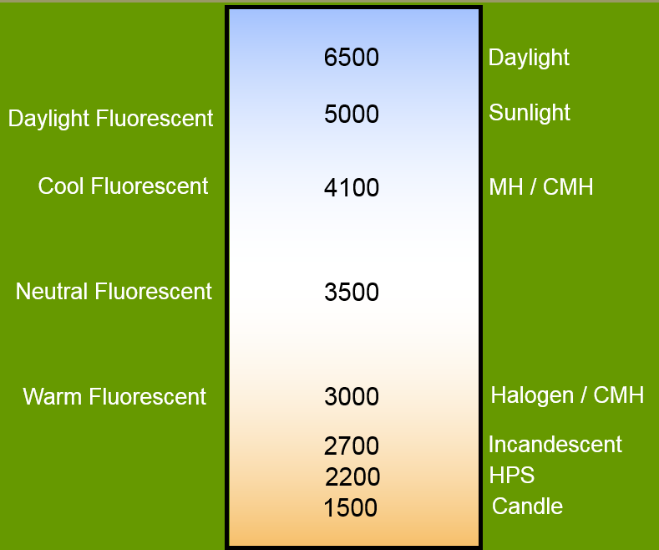
Lamp Characteristics: Color Temperature
The color temperature represents the appearance of a lamp as rated in degrees Kelvin (K)
Phosphor coating sets color temperature and CRI
Notes:
Color temperature describes “warm” or “cool” appearance and has nothing to do with the temperature of the lamp.
Higher color temp is cooler in appearance:
(Example: 4100K – cool fluorescent)
Lower color temp is warmer appearance:
(Example: 2700K incandescent)

Slide 14
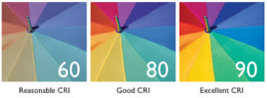
Lamp Characteristics: Color Rendering Index (CRI)
Appearance of colored objects when viewed under a light source compared to when viewed under daylight (of same color temp)
Relative measure (0 to 100)
The higher the CRI, the truer the object colors appear
Notes:
Color Rendering Index (CRI) values range from zero up to 100 percent.
Note:
1) Two light sources may have the same CRI, but one may do a better job on the green-blue range, while the other is better in the red-orange range.
2) Therefore, a comparison is only valid when the light sources have the same color temperature.

Slide 15
Light Source Color Summary
CRI CCT¹ (°K)
Natural daylight 100 5000 – 8500 Mercury vapor 20-50 4000 – 6000
Metal halide 65-93 2900 – 6500
Fluorescent 50-96 3000 – 8000
Incandescent 100 2500 – 3000
Induction 80 2700 – 5000
Standard HPS 22 2200
LED 60-90+ Varies
Low pressure sodium 0 1700
Notes:
Note:
Even though incandescent bulbs are deficient in the blue part of the spectrum, they are rated at 100 CRI.
__________________
¹ CCT stands for Correlated Color Temperature, which is a specification of the color appearance of a light source. See the glossary for a complete definition.

Slide 16

What Light Levels are Needed?
Proper light levels required
IES recommendations
State/local standards
Where light levels are correct, visual tasks are easier
Students/workers can see well
Maintenance personnel maintain proper levels, and correct improper light levels
Too high or too low
Notes:
Visual tasks are easier when the proper light levels are provided. Light level recommendations are set by state and local standards.
The role of the building operator is to maintain proper light levels and to correct light levels that are below standards.
Correcting light levels that are too high will save energy after they are corrected.

Slide 17
Recommended Light Levels
Based on IES recommendations, expressed in average maintained footcandles
Auditorium (assembly) 3-10
Classrooms/Lecture Rooms
Regular desk work, study halls 30-50
Lecture rooms (audience) 100
Demonstration areas 100-200
Corridors, Lobbies and Stairways 10-40
Food Service Facilities
Food preparation task areas 50-100
Gymnasiums
General 30
Competition and events 50-150
Notes:
These values are based on IES guidelines and serve as a starting point for evaluating lighting levels in commercial spaces. Lower or higher values may be appropriate, depending on specific facility and/or occupant needs.
Average Maintained Footcandles are values that refer to an average of light levels throughout a space. It does not mean the light levels everywhere in the space must exceed the recommended footcandle (FC) level.
Maintained Footcandles refers to light levels that result after a given period of lumen depreciation; and, it is expressed as “mean” or “design” footcandles.

Slide 18
Recommended Light Levels
Libraries (reading) 20-50
Lounge and Waiting Areas 0-30
Offices
Paperwork (#2 pencil; 8pt or 10pt print) 30
Computer use (vertical fc) 5
Accounting, bookkeeping (on paper) 50-100
Conference areas 20-70
Rest Rooms 7.5-30
Storage Areas 10-30
Notes:
Recommended light levels consider the workplane, whether that is a desktop, the surface of a chalkboard, or the floor in a corridor.
Refer to the Appendix for a Foot Candle Lighting Guide that includes more occupancy and task applications.

Slide 19
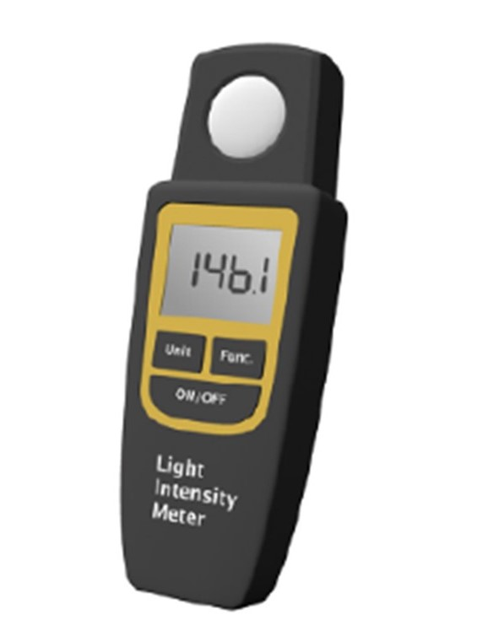
Light Level Meter
A light level meter measures illumination levels in a space in footcandles
footcandles

Slide 20
Measurement Tips
Take measurement at task surface
Do not obstruct or shadow meter
Calculate average from maximum & minimum readings
Account for daylight effects (with and without)
Notes:
To use a light meter correctly:
Do not block the light from getting to the meter.
Measure light level at task surface.
In corridors, measure under one fixture and between 2 adjacent fixtures, then average readings.
Calculate average = (Max + Min)/2
To account for daylight effects:
Take reading with both electric light on and daylight present.
Turn off electric lights and take a second reading, which is daylight only.
Subtract the two readings. The result will account for electric lights only.

Slide 21

Learning Activity #3
Lighting Levels
Turn to the Appendix of your handbook
Notes:
Please turn to the Appendix of your handbook to complete Activity 3.

Slide 22
Discussion Question
What are your lighting levels at your workspace in foot candles with task light on? What about with the task light off?
70+
50-70
30-49
20-29
Less than 20

Slide 23
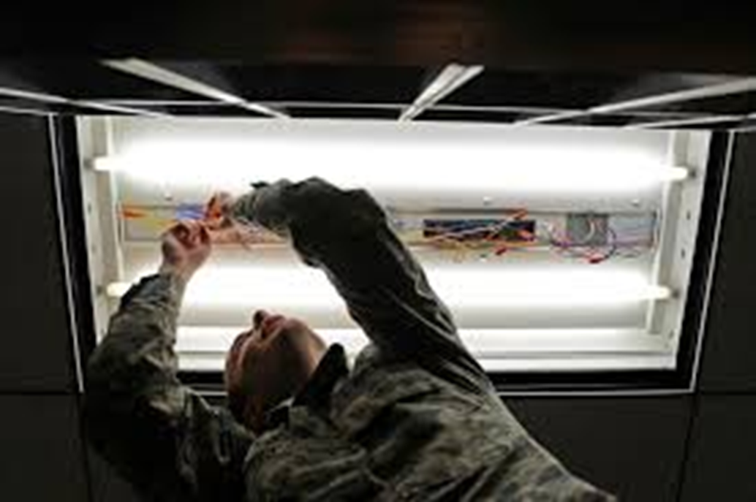
Lighting Equipment
Light Fixture
Lamp - Fluorescent Tube
Ballast

Slide 24
Lighting Equipment
Common Types of Lamps
Incandescent
Standard (Filament)
Tungsten-Halogen
Halogen Infra-red (HIR)
Fluorescent
Tubular
Compact (CFL)
T-12
T-8
T-5
Notes:
Common lamps are organized into major families.
Incandescent lighting uses a coiled metal resistor called a filament within a glass bulb filled with an inert gas. Electricity passes through the filament, causing it to heat up to high temperatures, which results in visible light being emitted.
Fluorescent lighting produces light when an electric filament excites mercury vapor within the lamp that in turn emits ultraviolet light. The ultraviolet light causes a secondary phosphorescent vapor to emit visible light.

Slide 25
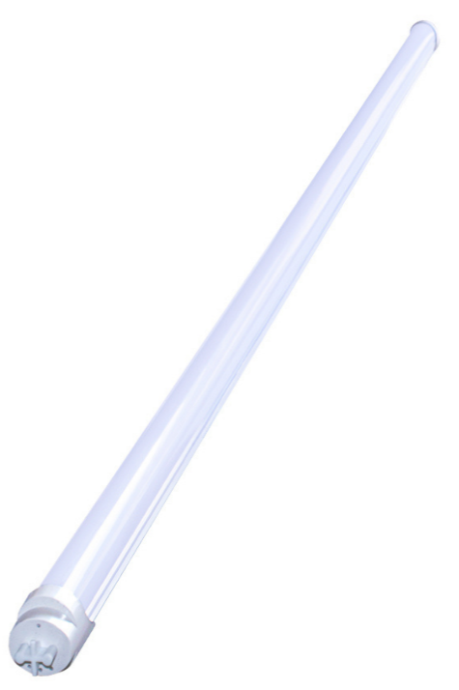
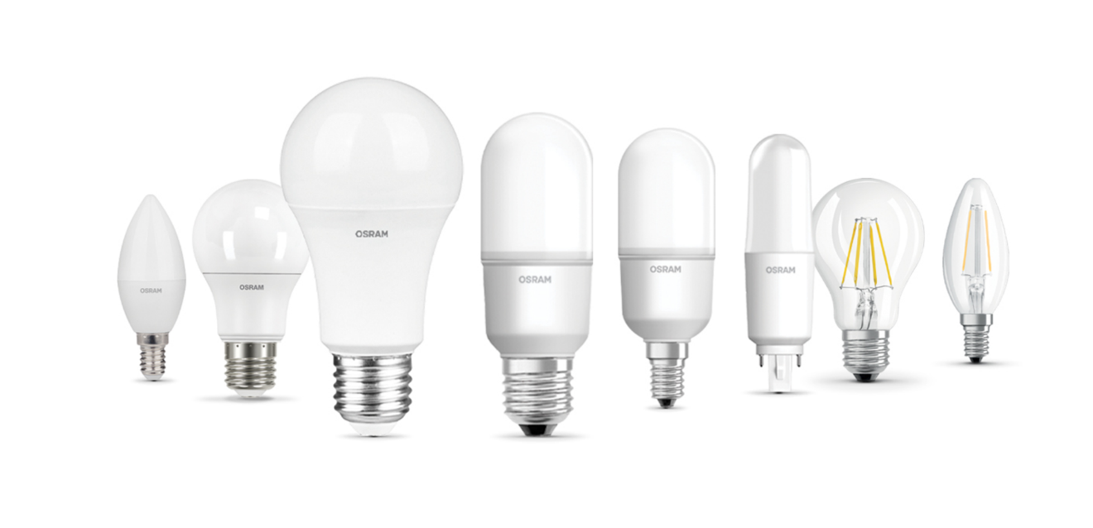
LED
Light Emitting Diodes (LEDs) are solid-state semiconductor devices that convert electrical energy directly into visible light
Arrays of LEDs are used to produce solid state lighting (SSL) lamps and fixtures
Notes:
When certain chemical elements are combined and electrical current passes through them, photons (light) and heat are produced.
The attributes of LEDs include:
Long life - LEDs have a usable life of about 50,000 hours compared to 750 – 1,000 hours for typical incandescent bulbs.
Vivid Colors - LEDs give pure saturated colors with up to 130% more color gamut compared to standard NTSC specifications.
High reliability - LEDs are solid state devices, no moving parts, no glass and no filaments to break.
Energy efficient - LEDs use up to 90 percent less energy
Environmentally friendly - LEDs contain no mercury and since they last longer, there is less disposal waste in the environment.

Slide 26
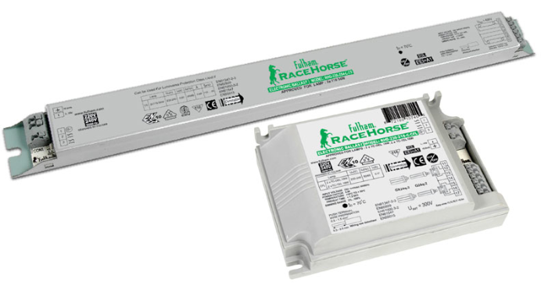
Ballasts
Electrical devices to start and operate fluorescent and HID tubes/bulbs
Functions:
Provide correct voltage to start arc discharge
Limit/stabilize supplied current to design value (ex: 265 mA T8)
Provide energy to heat cathodes
Notes:
Ballasts are electrical devices that start and operate fluorescent and HID tubes. They provide the correct voltage to start arc discharge and limit the current to the design value of the fixture. In the case of rapid-start and programmed-start fluorescents, they also provide energy to heat the cathodes.
Mismatched ballasts can reduce tube life and/or light output, or they may not start the tube at all.
Ballasts employ integrated circuits to operate lamps at high frequencies (25,000 Hz or higher) - more efficient than line frequency.
Magnetic ballasts are not common but sometimes exist in older buildings with T-12 lamps. They are very inefficient and are distinguishable by their buzzing and flickering. A quick trick to determine whether a ballast is magnetic or electronic is to take a photo of the lamp (while turned on) with your cell phone.
If the photo looks normal, it is most likely an electronic ballast.
If there are noticeable stripes or bands across the photo, it is probably magnetic.
It is possible to replace magnetic ballasts with electronic ballasts, but upgrading fluorescent lights to LED is recommended and is typically the most cost-effective option.

Slide 27
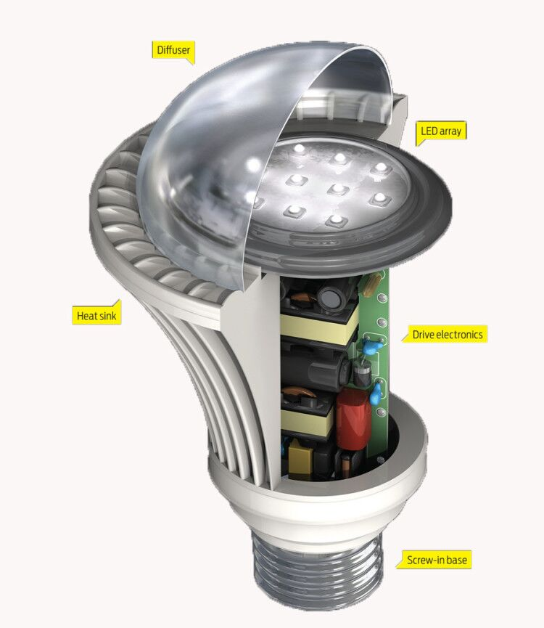
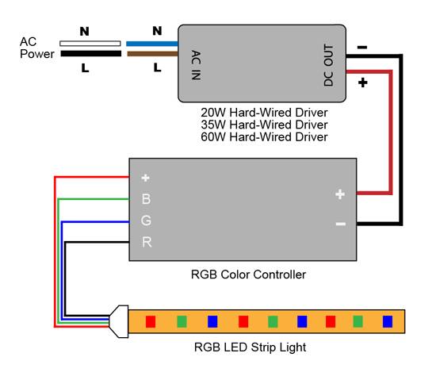
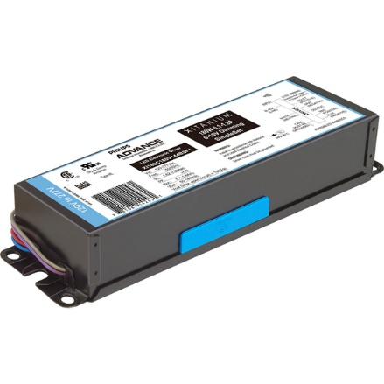
LED Driver
Self-contained or remote power supply
Outputs matched to the electrical characteristics of the LEDs
Self-contained driver
Remote driver
Notes:
LED drivers (also known as LED power supplies) are similar to ballasts for fluorescent lamps or transformers for low voltage lamps. They provide LEDs with the electricity they require to function and perform at their best. LEDs require drivers for two purposes:
LEDs are designed to run on low voltage (12-24V), direct current (DC) electricity. However, most facilities supply higher voltage (120-277V), alternating current (AC) electricity. An LED driver rectifies higher voltage AC to low voltage DC.
LED drivers also protect LEDs from voltage or current fluctuations. A change in voltage could cause a change in the current being supplied to the LEDs. LED light output is proportional to its current supply, and LEDs are rated to operate within a certain current range (measured in amps). Therefore, too much or too little current can cause light output to vary or degrade faster due to higher temperatures within the LED. In summary, LED drivers convert higher voltage AC to low voltage DC. They also keep the voltage and current flowing through an LED circuit at its rated level.
RGB LED means red, green, and blue LEDs. RGB LED products combine these three colors to produce over 16 million hues of light. Some colors are “outside” the triangle formed by the RGB LEDs. Also, pigment colors such as brown or pink are difficult, or impossible, to achieve.
Self-contained driver
Remote driver

Slide 28
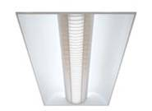
Fixtures
Fixtures are lighting units that contain lamps, ballasts, sockets and wiring to provide light in spaces. There are many different types of fixtures.
Notes:
Developments in energy-efficient lighting have occurred rapidly over the last several years.

Slide 29
Fixtures
Lamp type – (incandescent, compact fluorescent (CFL), fluorescent, HID)
For SSL, no lamp type since LEDs integrated into fixture
Nominal size – (2x2, 2x4, 1x4, 6” can ..)
Number of lamps per fixture
Mounting – (recessed, surface, pendant..)
Location – (ceiling, wall, floor, cove…)
Light spread - (direct, indirect, direct/indirect – see notes below)
Light control – (none (open), lens, louver, baffle)
Notes:
Fixture definitions:
Direct: Mostly down.
Indirect: Mostly up.
Direct/Indirect: About equally down and up.
Diffuse: About equally in all directions.
Directional/Adjustable: Evenly distributed in one direction.
Asymmetric: Unevenly distributed – like wall washer fixtures.
Recessed: Entirely above the ceiling, or within the wall, flush on a surface.
Surface: Entirely below the ceiling, or part of the wall, not flush (it could also be semi-recessed).
Pendant: Suspended by stem or aircraft cable, below the ceiling.
Track: Detachable, moveable heads along a track system.
Post-top: Exterior fixture, independent of posts or bollards.

Slide 30
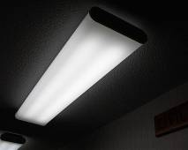
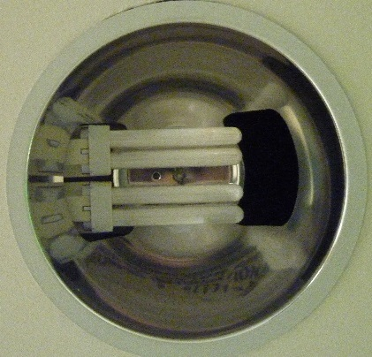
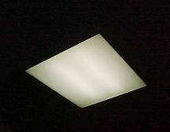
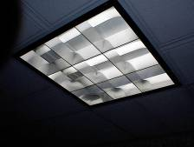
Fluorescent Fixtures
Housing
Electrical Connection
Sockets
Tubes & Ballasts
Shielding/Diffusing Media
Reflecting Means
Trim
4-ft wrap-around
surface mount fluorescent
6” recessed downlight (can) compact fluorescent
2x2 recessed lensed fluorescent
2x2 recessed parabolic fluorescent
Notes:
Fluorescent fixtures come in a variety of shapes and sizes. Here are an example of different types such as surface mount, recessed downlights, parabolic and prismatic lens.
Fluorescent fixtures can be surface, recessed, or pendant mount depending on the application. Ballasts are typically mounted within the fixture housing near the electrical connection point.
Sockets or lamp holders are sometimes called “tombstones.”
A diffusing media or specular reflecting is used to direct the light out of the fixtures.

Slide 31
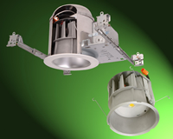
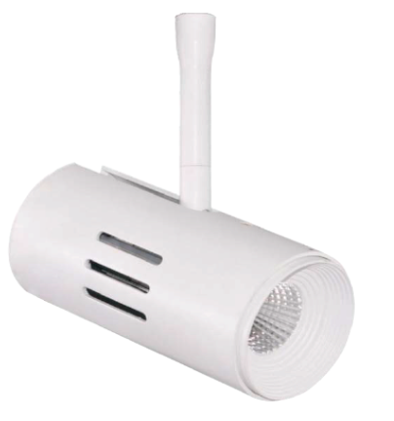
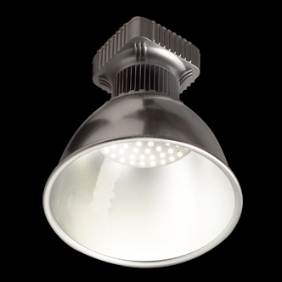

Solid-State (SSL) Fixtures
LED down-lights
Cost-effective & current practice in new construction market
LED track systems
Good solution for highlighting
SSL troffers
LED panels
High/Low bay Fixtures
Warehouse and retail applications
Notes:
LED down-lights also known as recessed cans are now cost-effective and the best solution over all other incumbent technologies.
Solid-State Lighting (SSL) troffers are becoming more affordable and can be cost-effective in high hours-of-use applications.
In general, SSL fixtures have thermal advantages and work well in freezers or exterior applications in cold climates down to -30˚F, but an often overlooked issue with LEDs is excessive heat levels. Operators believe – incorrectly – that the low wattage in LEDs means they generate less heat. LED lamps and fixtures must be ventilated to keep the LED system cool. Some manufacturers are designing fans into LED fixtures to address issues surrounding excess heat.

Slide 32
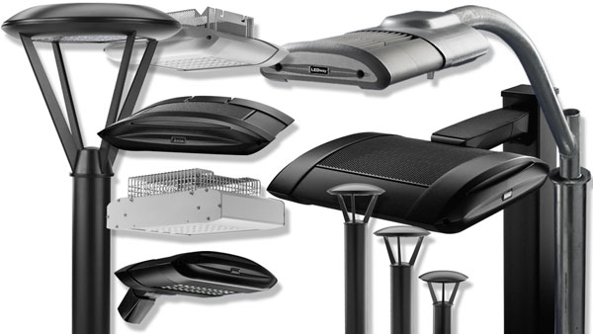
Solid-State (SSL) Fixtures
Wall Sconces & Parking Lot Fixtures
Good uniformity of lighting
Notes:
SSL are often called sconces to differentiate from the poor reputation of wall packs (mostly glare).
Many new SSL wall sconces qualify as “Dark Skies” compliant, eliminating sky glow and light trespass, through superior optics over existing wall packs.
There are excellent opportunities for SSL fixtures in outdoor applications.
Consider controls either now or that can easily be added later when community codes are expected to require lower light levels (or turn-off) when there is no activity.

Slide 33
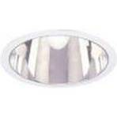
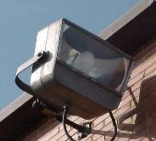
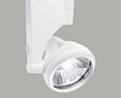
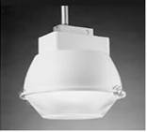
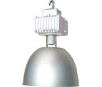
HID Fixtures
High-intensity discharge
Pulse-start (PS)
CMH metal halide
High-pressure sodium (HPS)
Outdoor
Floodlights, parking lots, roadways
Low- & high-bay applications
Industrial, gymnasiums, warehouses
Note: Best practice for efficiency is to replace HID fixtures with SSL fixtures
Notes:
High-intensity discharge (HID) fixtures are common in exterior lighting applications, sports field lighting, and low/high-bay applications in warehouses, industrial, and gymnasiums.
The manufacturing of HID fixtures continues to decline as end-users continue to adopt other technologies, like Solid-State Lighting (SSL).

Slide 34
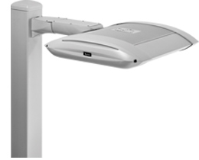
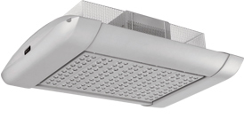
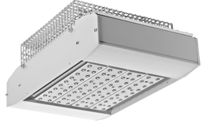
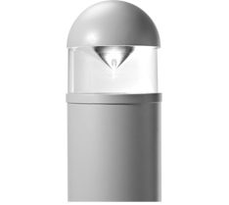
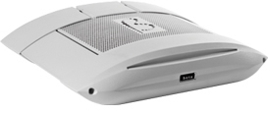
Area Lighting Fixtures
canopy
outdoor area
parking structure
wallpack
bollard
Notes:
Area lighting fixtures come in a variety of shapes and applications:
Outdoor Area lighting fixtures area generally pole mounted and used to light parking areas or sport activity fields.
Parking Structure and Canopy fixtures have a low-profile enclosure to maximum head room.
Wallpack fixtures are attached to the exterior of the building to provide lighting at entrances and for security purposes.
Bollards are used for landscape and pathway lighting.

Slide 35
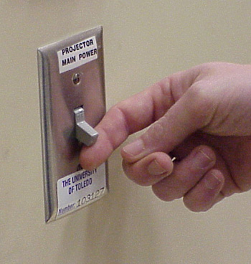
Controls
Notes:
Lighting Controls are used to control the time lighting systems are operated (such as with wall switches) or to control the power used (such as with dimmers).

Slide 36
Lighting Control Strategies
Switching (manual or automatic)
Scheduling (lights off when not needed)
Tuning (ensures right amount of light at the task)
Daylight Harvesting (responds to changing conditions)
Lumen Maintenance (compensates for depreciation)
Demand Limiting (sheds or dims lighting at peak times)
Demand Response (utility requests to shed load or automatic)
Notes:
Lighting Control Strategies
Scheduling: Using operating schedules and time controls to turn lights on when needed and off when not needed.
Tuning: Adjusting lights to levels appropriate to the existing occupancy, tasks, or conditions.
Daylight Harvesting: Turning off or dimming electric lighting when sufficient daylight is available.
Lumen Maintenance: Compensating for the “overdesign” of new lighting systems by dimming and then gradually increasing power delivered to lamps over their life cycle.
Demand Limiting: Detecting a building’s peak power demand and slowly reducing power to lighting or other energy systems to reduce utility demand charges.

Slide 37
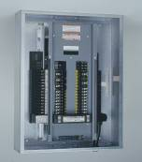
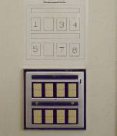
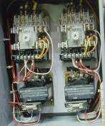
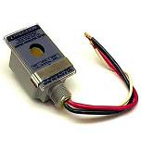
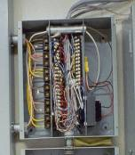
Switching (On/Off) Controls
Wall Switches
Line voltage
Circuit breakers
Not recommended to use as switches
Low-voltage switches/
Latching relays
Best for large facilities BMS
Contactors
Lighting relays
Photocells
Use silicon instead of CdS
Notes:
Many facility types, including warehouses, industrial, commercial, gymnasiums, etc., use circuit breakers as a way to routinely switch lights on and off. This is not a good idea.
Circuit breakers fail to trip on overload due to spring wear if continuously used as a switch.
If that is the only way you can switch lights, then replace with switch duty (SWD) breakers or use switches or relays to switch.
CdS – cadmium sulfide cells are used in cheaper dusk-to-dawn controls. They change sensitivity over time (cadmium in CdS cells is a heavy metal versus electronic units that use silicon cells). Replace cadmium with silicon for reliability and longer life. This will also save energy (fewer dayburners).

Slide 38
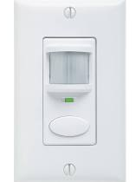
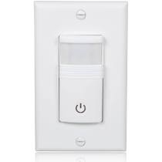
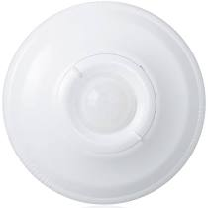
Occupancy Sensors
Notes:
Occupancy sensors are a form of lighting controls that automatically turn off lights when areas are unoccupied. According to ASHRAE’s Advanced Energy Design Guide for Small to Medium Office Buildings, occupancy sensors can save 15% to 20% on lighting energy costs.

Slide 39
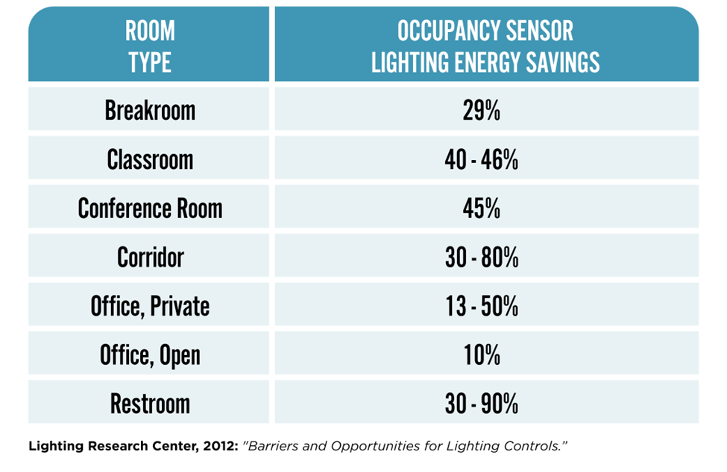
Occupancy Sensor: Application Savings
Notes:
Sensors can be most effective in areas frequently unoccupied, such as restrooms, conference rooms, corridors, and other spaces, as shown in the table of predicted savings here.
Source: Lighting Research Center, “Barriers and Opportunities for Lighting Controls.”

Slide 40
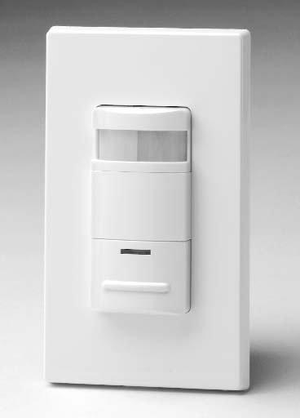
Vacancy Sensors
Like an occupancy sensor operated in “manual on” “auto-off” mode
Saves more energy than occupancy sensors
Best application is individual offices and conference rooms with access to daylighting
Many situations where there is brief occupancy don’t need lights on, e.g.:
Janitor visits to dump waste basket
Colleague visits to deliver papers
Notes:
Some occupancy sensors provide “Manual On/Automatic Off” mode of operation, and this is how vacancy sensors work.
Vacancy sensors are particularly well suited to applications where room lights do not need to be turned on when someone enters the room. For example:
A custodian visits a room to dump the waste can.
A colleague visits to deliver papers.
Offices and conference rooms which have access to natural daylight let the occupants decide when to turn the lights on.
Due to their relative simplicity and high energy-savings potential, coupled with energy code mandates, occupancy and vacancy sensors are a staple in new construction. They are also a commonly required by code as a control feature in remodel projects. It’s advisable to consult your local code for lighting control requirements in new construction and major remodels.

Slide 41
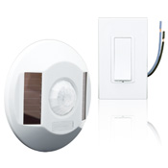
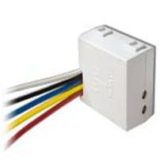
Wireless Occupancy Sensors & Relays
Ceiling mounted PIR occupancy sensors
Requires NO hard-wired electricity
Ideal for retrofit applications
Long-life battery or no battery
Ideal for dimming applications
PV cells in sensor keep capacitor charged
Relays operated by RF from sensors
Communicate with wall-box unit (or wireless relays) using Radio Frequency (RF)
Notes:
Wireless sensors allow the desired ceiling location without wiring and wireless relays can eliminate wall switches (or disabled for automatic control).
The photo-voltaic (PV) cell keeps a capacitor charged in one manufacturer’s model.
Wireless relays can provide sub-zones within a space or individual control of fixtures.

Slide 42
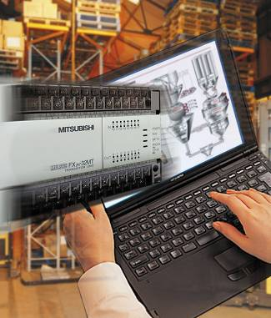

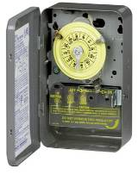
Scheduling Controls
Control strategy that turns lighting systems on and off according to a predetermined schedule
Time-based function; best suited for facilities with predictable schedules
Time control types:
Preset
Electromechanical
Electronic/digital
Astronomical
Notes:
Time controls are also known as timers, time clocks, or time switches.
Building Management Systems (BMS) can also provide the time-of-day control.
Astronomical timers turn exterior lighting on at sunset and off at sunrise (or a programmed time).

Slide 43


Scheduling Controls
Notes:
Scheduling adjusts the output of the lighting system based on a time event implemented using a time-clock, which may be implemented using a microprocessor built into the control system. At certain times, controlled lights will turn ON, OFF or dim to either save energy or support changing space functions. Scheduling is highly suitable for larger, open spaces that are regularly occupied as well as spaces that are intermittently occupied but where the lights must remain ON all day for safety or security reasons. Local override (time extension) wall controls are often used to allow for irregular use of the space. Occupancy-based strategies (lumping together time scheduling with occupancy sensing) can realize 24% average lighting energy savings, according to Lawrence Berkeley National Laboratory (LBNL).

Slide 44


Daylight Harvesting Controls
Use dimming or switching to save energy where natural daylight is available
Requires dimmable lighting fixtures
Image source: https://www.mdpi.com/2071-1050/13/9/4973
Image source: LED Network
Notes:
Daylight harvesting systems use available daylight to offset the amount of electric lighting needed to properly light a space, in order to reduce energy consumption. This is accomplished using lighting control systems that can dim or switch electric lighting in response to changing daylight availability.
All daylight harvesting systems use a light level sensor or a photosensor to detect the prevailing light level, illuminance or brightness. Photosensors are used to adjust electric lighting based on the available daylight in the space. The signal from the photosensor must be carefully calibrated to accurately indicate the effect of exterior daylight variations on the light level in 'important function' areas in the space. Proper placement of the sensors is also very important.
Energy savings from daylight harvesting for electric lighting in the range of 20-60% are common. Savings are very dependent on the type of space the light harvesting control system is deployed in, and its usage. Clearly, savings can only accrue in spaces with substantial daylight where electric lighting would have been otherwise used. Therefore, daylight harvesting works best in spaces with access to conventional daylight from windows, clerestory windows, skylights, light tubes, and glass block walls.
Image source: LED Network
Image source: https://www.mdpi.com/2071-1050/13/9/4973

Slide 45

Demand Limiting
Centralized control strategy
Automatically dim light fixtures to reduce electrical demand
Gradual dimming 5-10% = minimal impact on occupants
Can be integrated into utility demand response program
Notes:
Demand Limiting: Detecting a building’s peak power demand and slowly reducing power to lighting systems (or other energy systems) to reduce utility demand charges. Gradual dimming by 5-10 percent has minimal impact on occupants.
Demand Response: Responding to a signal from electric utility and slowly reducing power or switching off lighting systems in public spaces - similar to demand limiting.
Electric utilities may offer reduced electric rates for customers who agree to reduce their load upon request.

Slide 46

Luminaire Level Lighting Controls (LLLC)
LED fixtures with built-in sensors and controls
Networked connectivity with wired and wireless solutions
Digital control system w/ scheduling, tuning, load shedding, energy monitoring
Configurable for occupancy sensing, vacancy, daylight, continuous dimming
Notes:
Luminaire Level Lighting Controls (LLLCs) combine LEDs, controls, connectivity and data for a flexible lighting approach. Control strategies built-in to LLLC’s include occupancy sensing, daylight harvesting, continuous dimming and more. Connectivity can be wired or wireless providing flexibility in existing building applications. The fixtures are connected to a digital control system to provide remote monitoring and control all the way down to the fixture level. The control system can be configured to provide scheduling and illumination levels of individual fixtures or groups of fixtures, load shedding, adjustability by occupants and daylight harvesting.
Common applications of LLLC fixtures are office buildings, large retail spaces with skylights, and distribution warehouses with high-bay lighting.

Slide 47

Discussion
Lumens measures the ____________.
Lighting Facts
Serving Size: Lamp
Total amount of light
Light Output (Lumens) 800
Watts 12.5
Lumens/Watt 64
Watts measures ____________.
Power
Lumens/Watt measures the
____________.
Efficacy - how well a lamp converts electricity into light

Slide 48

Principles of Lighting Maintenance
Lighting system maintenance can maximize lighting benefits, including soft benefits
Better learning environment
Worker productivity & comfort
Poor maintenance will gradually lower performance
Systematic maintenance maintains light levels at design intent
Follow proper safety procedures (gloves, safety glasses, fall protection)
Notes:
A lighting system must be properly maintained to continue to provide high quality, efficient lighting.
Older, outdated lighting systems require a more robust maintenance program than an LED system.
Systematic lighting maintenance methods can help organize the process to ensure long-term benefits, including “soft” benefits (better learning environment and/or worker productivity).
When maintenance is NOT done – the system may perform at only 50-60 percent of capacity.
Note:
Lighting systems are often over-designed to compensate for future light loss resulting from lack of maintenance.

Slide 49
Cleaning of Fixture & Surface
Regular cleaning of light fixtures is one of the best ways to maintain performance
Essential to keep light reflecting surfaces clean
Wipe interior reflecting surfaces when changing lamps
Wipe off both sides of lenses, louvers, etc.
Use “Swiffer” or soft, cotton cloth
Use white gloves during installation of fixtures with specular surfaces & when changing lamps (can’t remove fingerprints)
Notes:
Keep light reflecting surfaces clean to maintain design light levels.
For dirty environments, clean fixtures before lamps burn out.
Use a soft, cotton cloth, and turn it often to present clean side to the surface.
“Swiffer” products are a good alternative to cleaning with a soft, cotton cloth.
White cotton gloves should be used when changing lamps with a glass surface or installing fixtures with specular (highly reflective) surfaces. Oils and residues from the skin can be transferred to the glass surface of the lamp, causing uneven lighting and/or shorter lifespan. And fingerprints can be impossible to remove from specular surfaces.

Slide 50

Control Adjustments
Check that time clocks and lighting control panels are set to correct time
Occupancy Sensors:
1. Adjust sensitivity as required to prevent air movement from being detected
2. Adjust delay to minimize lamp replacement and energy use:
LED/SSL > 5min
Programmed-start ballasts < 10 min
Instant-start ballasts > 15 min < 20 min
Notes:
Time clocks without backup power such as batteries or super capacitors (“super caps”) need to be checked regularly for correct time, in case of a power outage. Otherwise, lighting systems, especially outdoor systems, can be on during daylight hours, wasting energy (known as “day burners”).
Replacing older time clocks with new programmable units with backup power (“super cap” preferred) or using silicon photocells or building management systems (BMS) will prevent this waste.
Sensitivity controls should never be left in the “max” position but should be adjusted so that HVAC systems do not turn on lights when the fans start blowing air.
For optimum tube life, set delay time according to the type of electronic ballast being used: For programmed-start, delays down to 5 minutes can be selected; for instant-start ballasts, 15 – 20 min. In all cases settings should be at less than 30 minutes.
LED lamps and SSL fixture life are less affected by start/stop cycles, so sensor delay can be reduced to maximize savings.

Slide 51
Re-lamping Checklist: Group v. Spot Replacement
Replace T-12 lamps on group basis or as they burn out (spot re-lamping)
Group re-lamping not necessary for T-8 and T-5 lamps
Replace all tubes in the same fixture
Clean fixture reflecting surfaces, lenses, louvers, etc.
Dispose of spent lamp using environmentally sound practices and according to local codes
Evaluate group re-lamping versus spot re-lamping
The recommended practice is to replace fluorescent lighting with LED
Notes:
Spot re-lamping is when lamps are changed as they burn out.
Some organizations group re-lamp large areas and spot re-lamp between group re-lampings.
Group re-lamping is when lamps are replaced in whole area at a set time intervals. The best practice is to replace all lamps in the same fixture when one burns out and to clean fixture surfaces at the same time.
Dispose of lamps according to local environmental codes.
Group re-lamping became uncommon when the industry moved from T-12 lamps to T5 and T8 lamps many years ago. While T12 lamps rapidly lost their lumen efficacy as much as 60% within a few years, T8 and T5 lamps retain 95% lumen efficacy throughout their life. Group re-lamping was no longer needed with these newer lamps except under special circumstances, for example, a chip clean room. At this point, there are rarely T12 lamps in buildings in large enough quantities to warrant group re-lamping.
Recommended: consider retrofitting fluorescent lighting systems with LEDs, which can often have a very favorable payback and will result in substantial energy and labor savings over time due to their high efficiency and long life.

Slide 52


Benefits of Group Re-Lamping
Fewer work interruptions
Lower labor cost
More light
Fewer un-replaced burnouts
Less lamp stock
Notes:
Relamping is the act of replacing bulbs when they burn out.
Group relamping is a strategic maintenance practice where large numbers of bulbs are changed out on a predetermined schedule.
Before doing a group relamping project, consider replacing your lighting system with LEDs. The time and money for a group relamping project may be better spent on a new, LED system.
If replacement with LED’s isn’t an option, group re-lamping may be beneficial. There are fewer work interruptions than spot re-lamping that is usually done during normal work hours. The labor costs are lower because spot re-lamping involves a lot of wasted time, i.e. get the ladder, find out what lamp is needed, go get the lamp and so on. Group re-lamping affords more light since all lamps are near the same point in the depreciation cycle.
Most organizations do spot re-lamping between group re-lamps that result in fewer un-replaced burnouts. This is called interim re-lamping replacement. For example, when you group re-lamp, purchase 10% more lamps than required. Use these lamps for spot replacement and when your lamp stock is depleted it is time to group re-lamp. Less stock is required for group re-lamping and bulk purchases for the group usually result in lower lamp stock quantities.

Slide 53



Lamp Disposal
Fluorescent & HID lamps contain mercury and should be recycled - not thrown in the trash!
LED lamps/fixtures should be recycled as E-waste
Spent lamps are classified as “universal waste”
Incineration or landfill disposal pollutes environment
TCLP compliant lamps passed TCLP test
Notes:
TCLP compliant lamps have green ends. This means the lamp has passed the Toxicity Characteristic Leaching Procedure (TCLP).
Most contain less mercury than conventional lamps.
Photo at right shows mercury deposited on inner glass of fluorescent tube caused by cold air blowing on louver, pulling mercury out of the arc stream.

Slide 54


Ballast Disposal
Dispose of according to federal and local environmental laws
Recycle ballasts with PCB (or DEHP)
Electronic ballasts and LED drivers are considered E-Waste
Notes:
t capacitors replaced PCB as an insulator in 1979.
PCB-containing fluorescent light ballasts (FLBs) are a concern if they are leaking or they will be removed and disposed of as hazardous waste. According to EPA Toxic Substances Control Act (TSCA) regulations, the material must be incinerated. The entire lighting fixture does not need special handling and disposal as long as the ballast (electrical box) is not leaking. The non-leaking ballasts can be removed and recycled or disposed of properly.
FLBs containing PCBs that are currently in use have exceeded their designed life span. Sudden rupture of FLBs containing PCBs may pose health hazards to occupants and is difficult and costly to clean up. EPA recommends removing FLBs containing PCBs from buildings as soon as possible to prevent potential inhalation or dermal exposure.
When polychlorinated biphenyl (PCB) was classified as a hazardous material in 1979, manufacturers of fluorescent light ballasts turned to di (2-ethylhexyl) phthalate (DEHP) as a replacement. DEHP, however, has since been classified as a hazardous material, and its users must now find an environmentally-safe yet cost-effective way to dispose of the material.
DEHP, a clear, odorless, synthetic compound, is often used as a plasticizer. By 1985, most manufacturers had stopped using DEHP in ballasts for 4-foot fixtures but continued to use it for most 8-foot and high intensity discharge fixtures until 1991.
Recommendation: Always recycle older magnetic ballasts.

Slide 55
Discussion Question
True or False?
All fluorescent tubes contain mercury and should be recycled.
True
False

